Slide 1
Twitter Sentiment Analysis with News & Weather

Slide 2
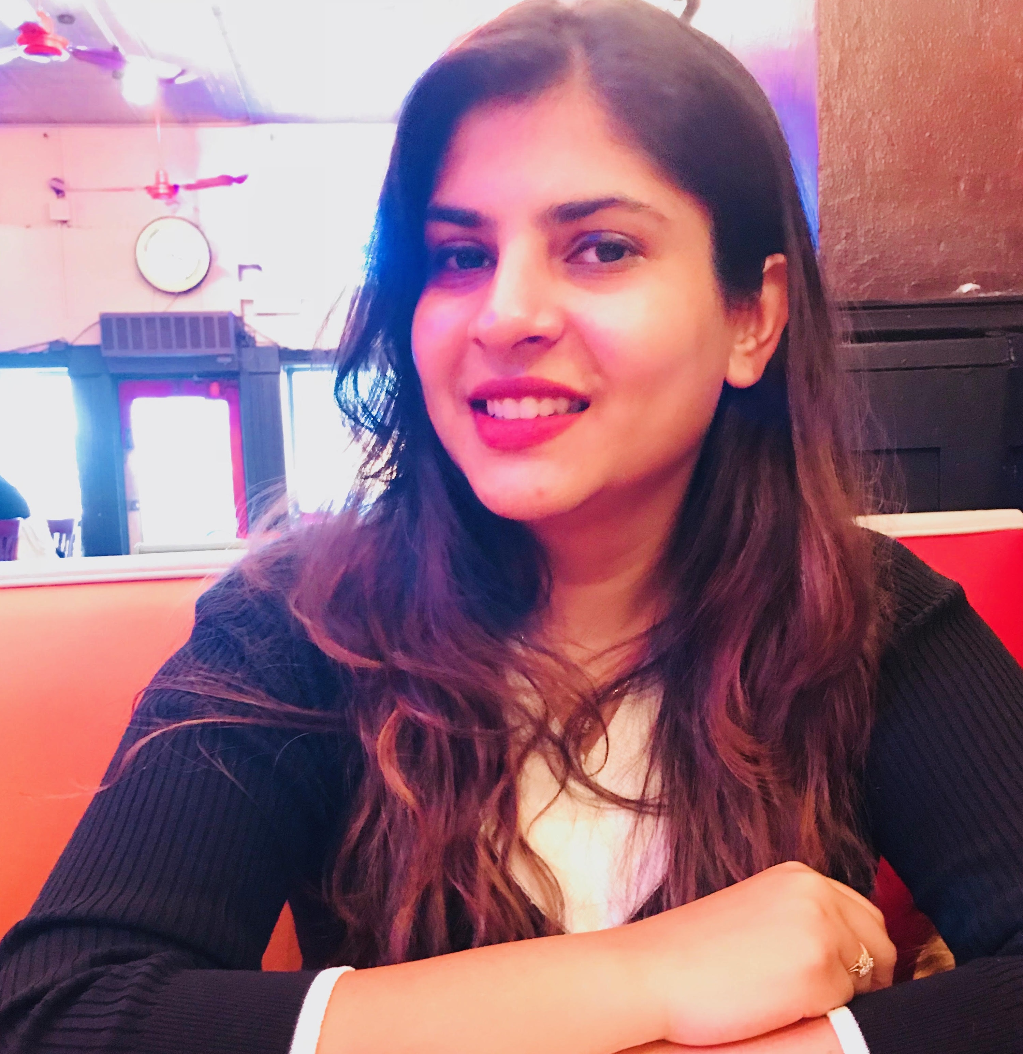
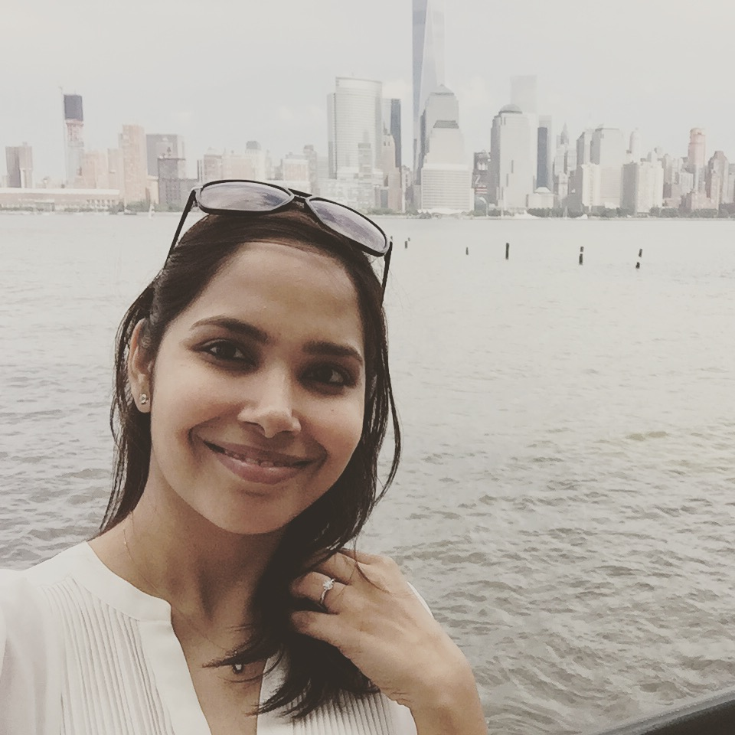
Sowmya
Vijayakumar
Dhavala
Manjunatha

Slide 3
What’s this about?

Slide 4
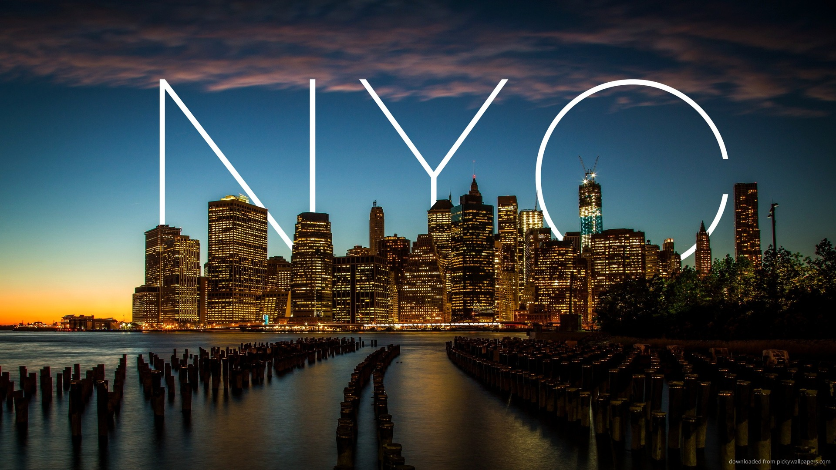
Want big impact?
Use big image.

Slide 5
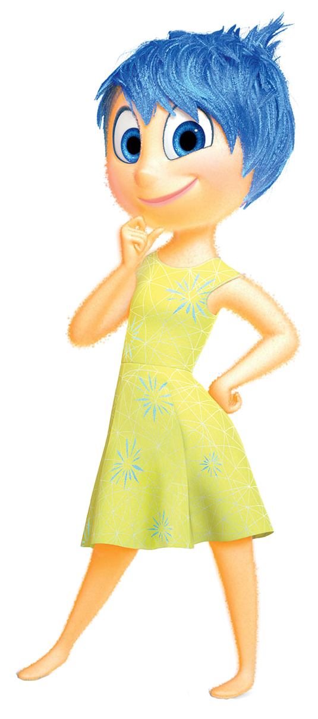
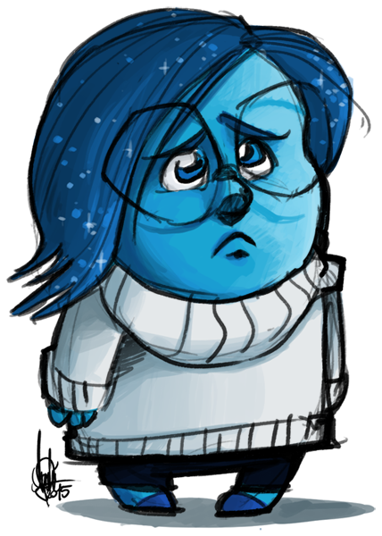
How’s NYC feeling today?

Slide 6
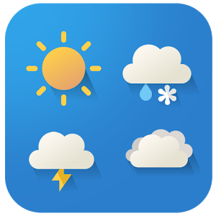


Slide 7
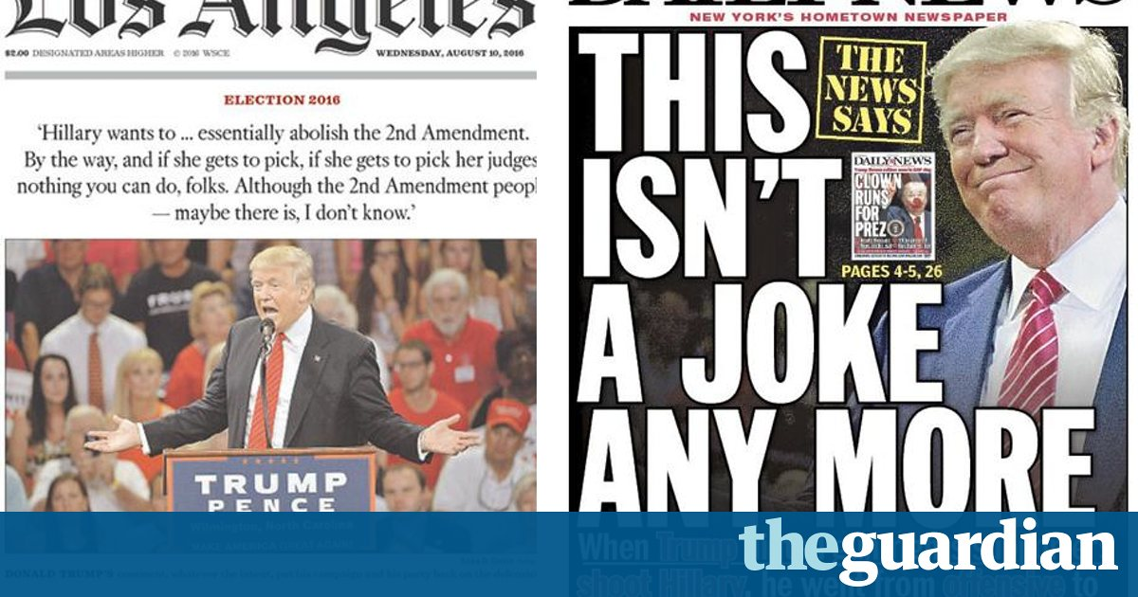
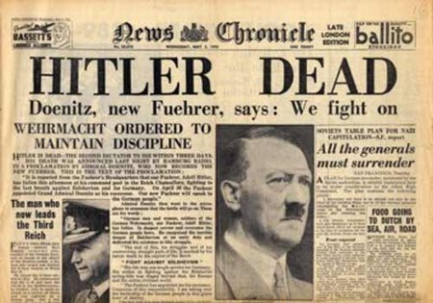

Slide 8
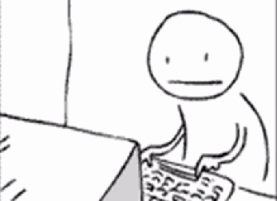
Data Collection

Slide 9
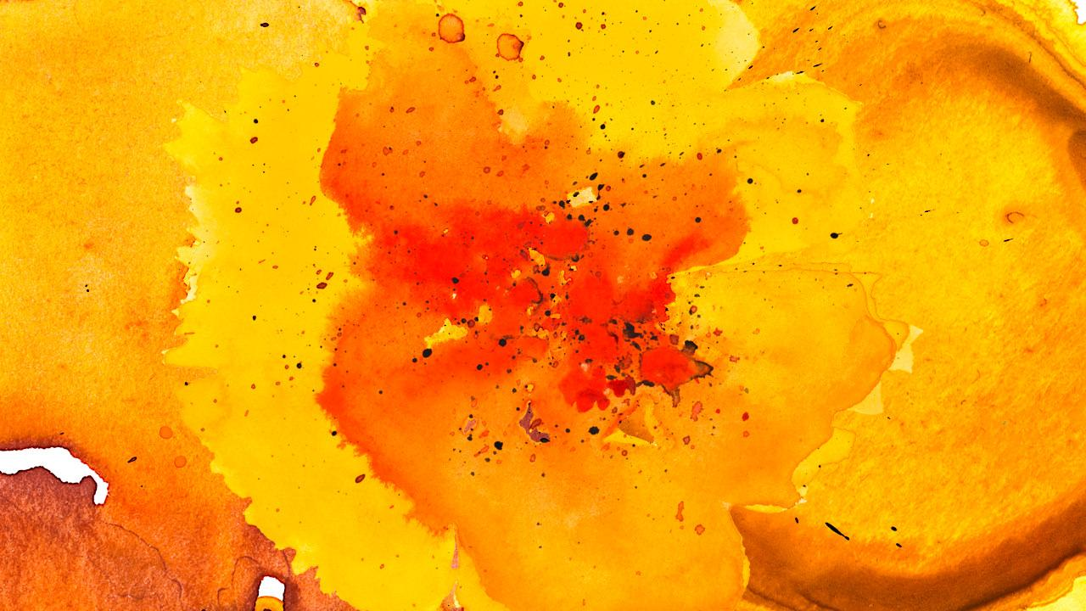


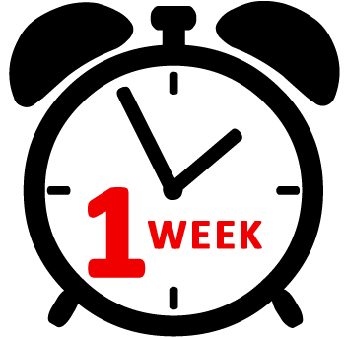

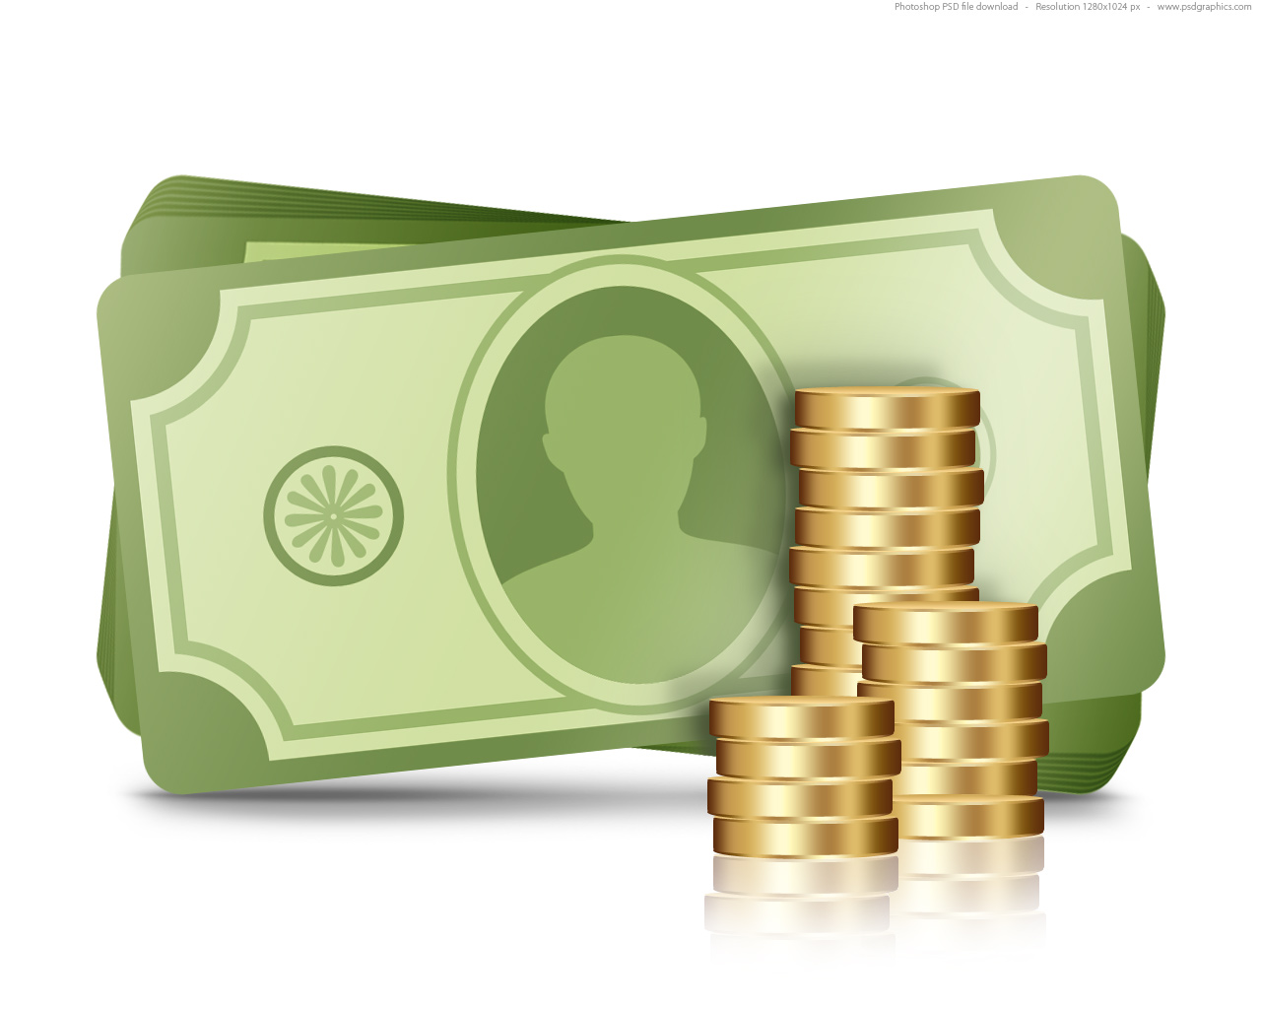
GNIP Tool
9

Slide 10

Mimic Twitter search through browser

Slide 11

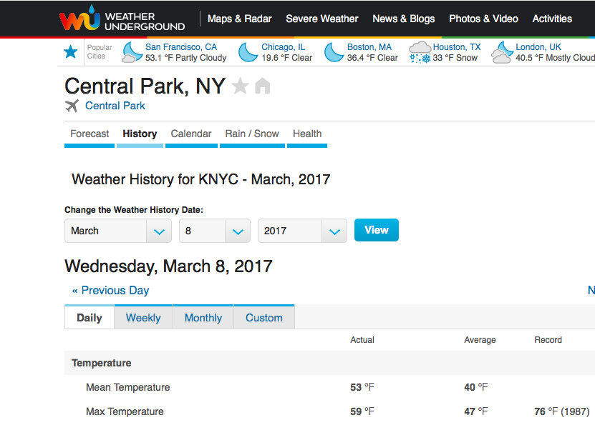

Slide 12

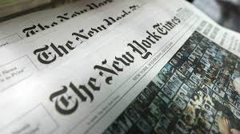


Slide 13
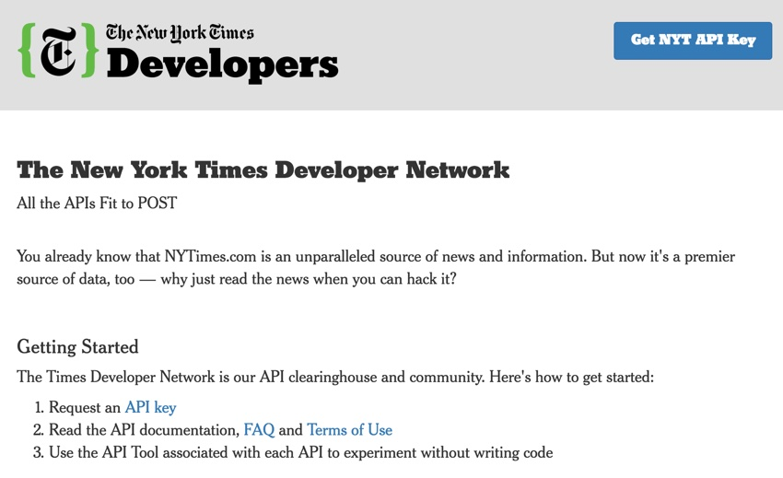
You can also split your content

Slide 14
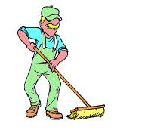
Data Cleaning

Slide 15
JSON > CSV
!*@#$&
Date Formatting
http://

Slide 16
Data Processing

Slide 17

Python Pandas
SentimentIntensityAnalyzer
TextBlob

Slide 18
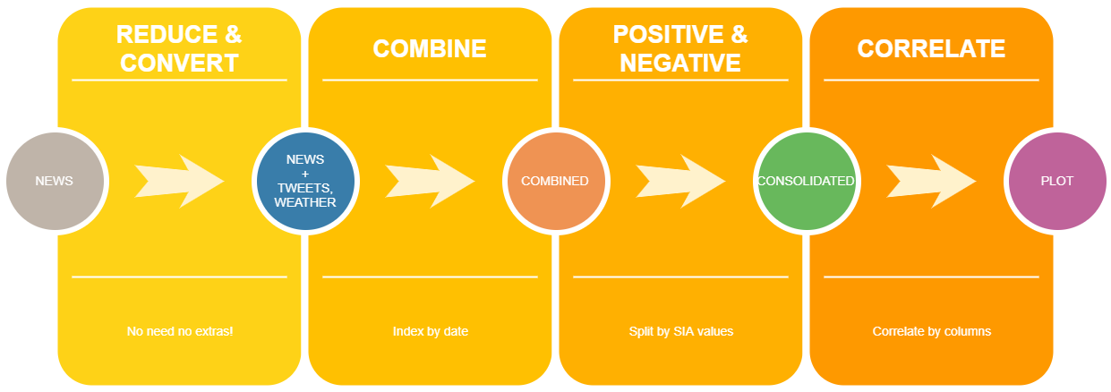

Slide 19
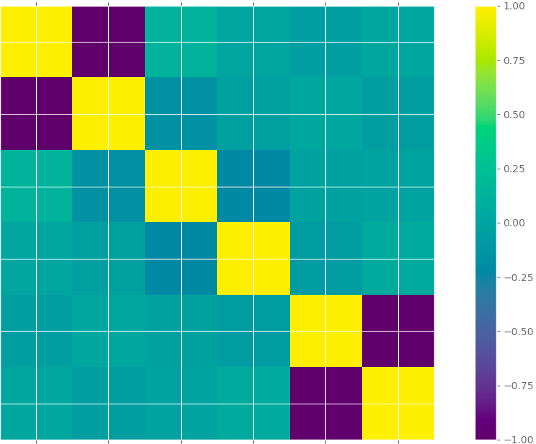
Positive
News
Positive
Tweets

Slide 20
Looking Forward!

Slide 22
Thanks!
Any questions?
You can find us at:
dmanjuna@stevens.com

Slide 23
Credits
Special thanks to all the people who made and released these awesome resources for free:
Presentation template by SlidesCarnival
Photographs by Unsplash
Watercolor textures by GraphicBurguer

Slide 24
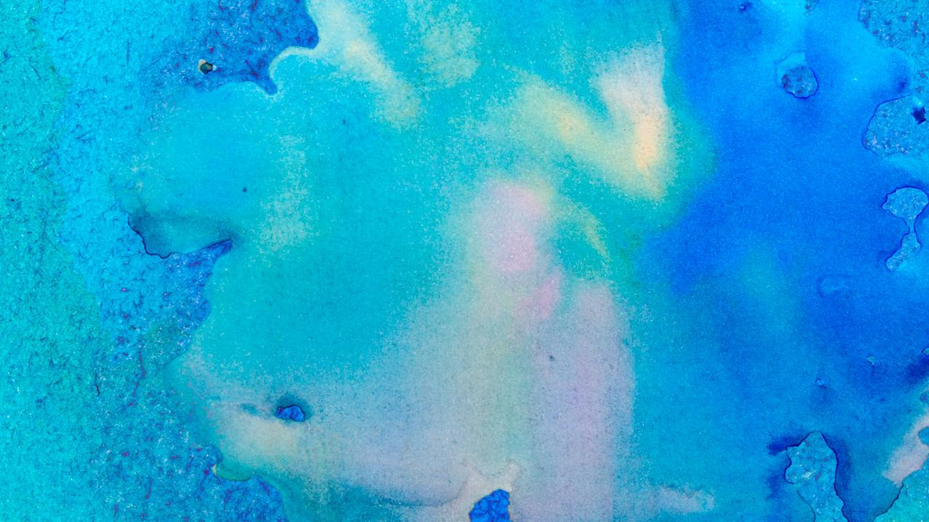
Maps
our office

Slide 25
89,526,124$
185,244 users
100%
That’s a lot of money
And a lot of users
Total success!

Slide 26
Our process is easy
first
second
last

Slide 27
Let’s review some concepts
Yellow
Is the color of gold, butter and ripe lemons. In the spectrum of visible light, yellow is found between green and orange.
Blue
Is the colour of the clear sky and the deep sea. It is located between violet and green on the optical spectrum.
Red
Is the color of blood, and because of this it has historically been associated with sacrifice, danger and courage.
Yellow
Is the color of gold, butter and ripe lemons. In the spectrum of visible light, yellow is found between green and orange.
Blue
Is the colour of the clear sky and the deep sea. It is located between violet and green on the optical spectrum.
Red
Is the color of blood, and because of this it has historically been associated with sacrifice, danger and courage.

Slide 28
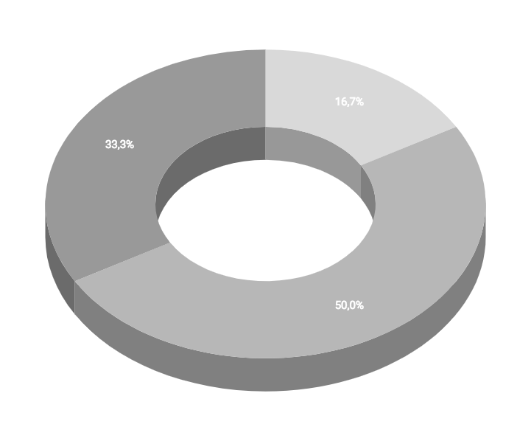
You can insert graphs from Google Sheets

Slide 29
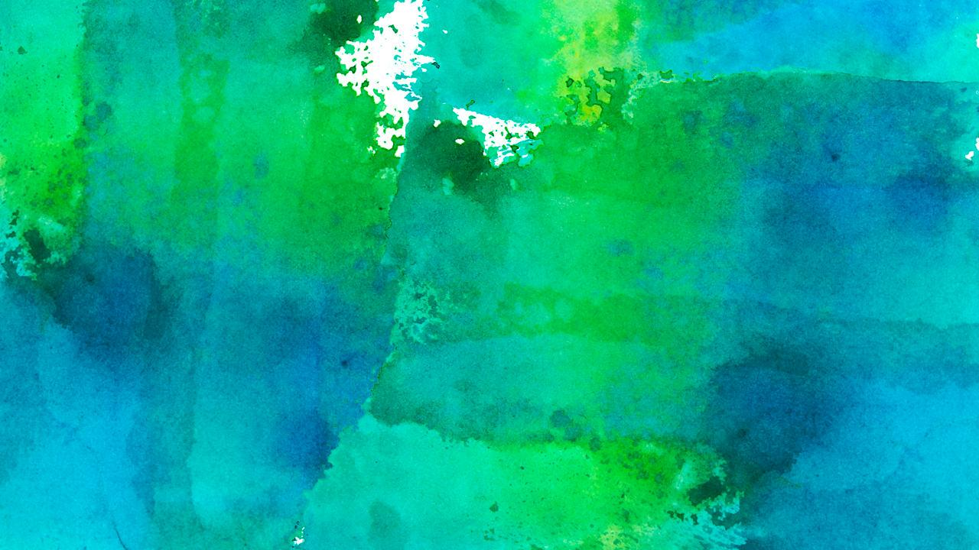
Android project
Show and explain your web, app or software projects using these gadget templates.
Place your screenshot here

Slide 30
iPhone project
Show and explain your web, app or software projects using these gadget templates.
Place your screenshot here

Slide 31
Tablet project
Show and explain your web, app or software projects using these gadget templates.
Place your screenshot here

Slide 32
Desktop project
Show and explain your web, app or software projects using these gadget templates.
Place your screenshot here

Slide 33
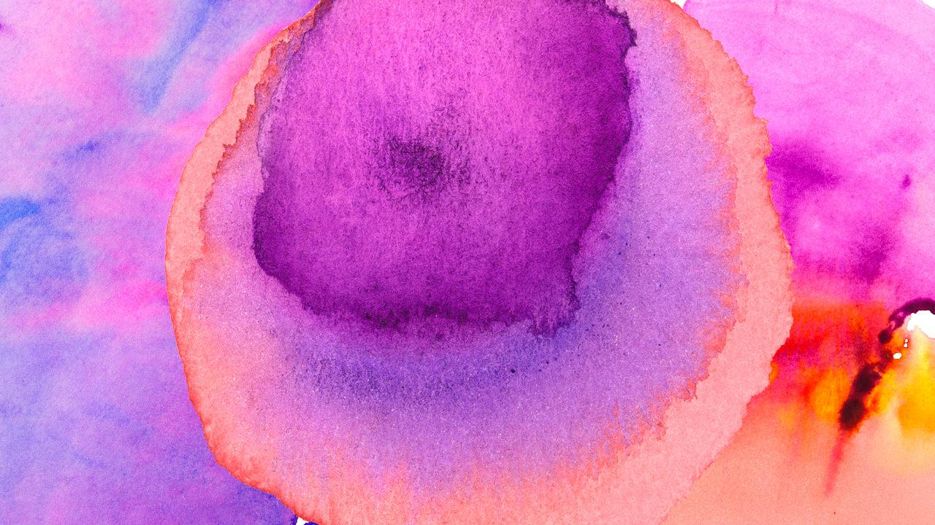
Thanks!
Any questions?
You can find me at:
@username
user@mail.me

Slide 34
Credits
Special thanks to all the people who made and released these awesome resources for free:
Presentation template by SlidesCarnival
Photographs by Unsplash
Watercolor textures by GraphicBurguer

Slide 35
Presentation design
This presentation uses the following typographies and colors:
Titles: Lato Thin
Body copy: Lato Light
You can download the fonts on this page:
http://www.latofonts.com/lato-free-fonts/
You don’t need to keep this slide in your presentation. It’s only here to serve you as a design guide if you need to create new slides or download the fonts to edit the presentation in PowerPoint®

Slide 36
SlidesCarnival icons are editable shapes.
This means that you can:
Resize them without losing quality.
Change fill color and opacity.
Isn’t that nice? :)
Examples:

Slide 37
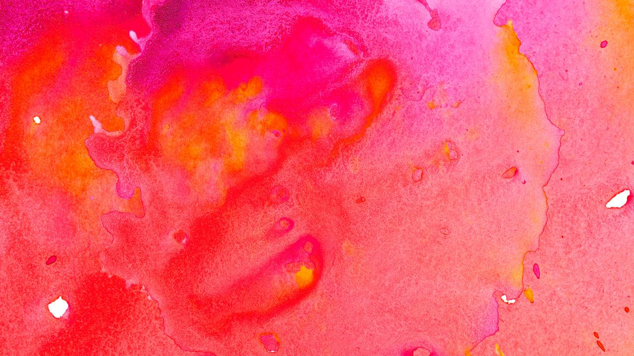
😉
Now you can use any emoji as an icon!
And of course it resizes without losing quality and you can change the color.
How? Follow Google instructions https://twitter.com/googledocs/status/730087240156643328
✋👆👉👍👤👦👧👨👩👪💃🏃💑❤😂😉😋😒😭👶😸🐟🍒🍔💣📌📖🔨🎃🎈🎨🏈🏰🌏🔌🔑 and many more...

